Slide 1
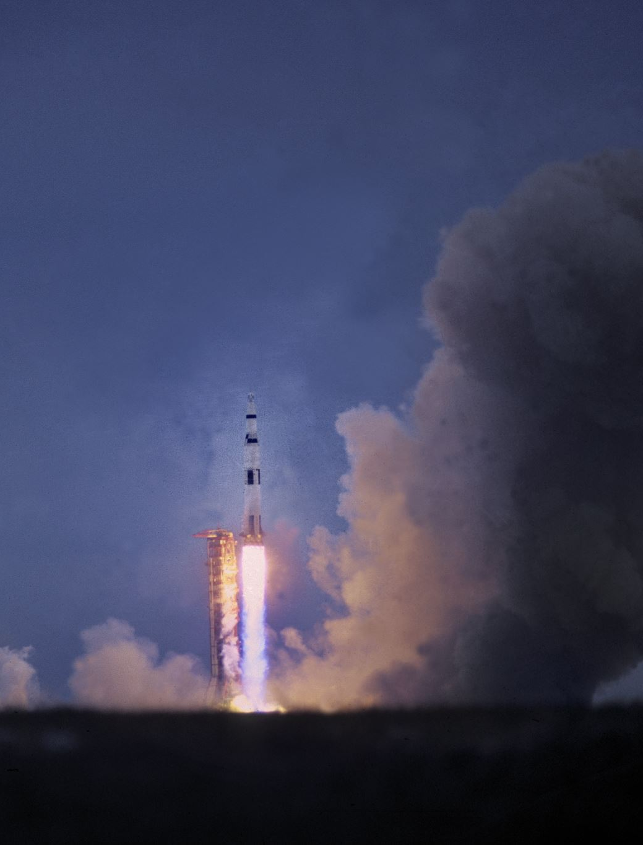
Compressible flow
revision

Slide 2
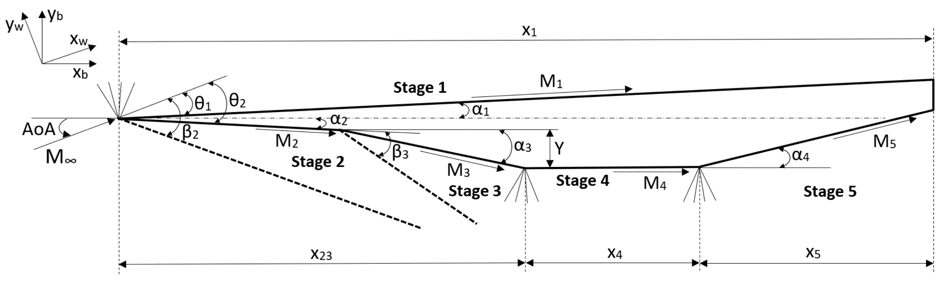
A hypersonic aircraft has a maximum speed of Mach 6.7 in atmosphere T = 226 K and p = 0.01197 bar. The wing shape has a 6 degree included angle at the leading edge. Determine the possible shock angles and for the weak shock, calculate the Mach number after the shock. Ignore angle of attack and assume a symmetrical flow about the horizontal plane through the nose centre point. [11°, 88°, 5.76]
https://www.mdpi.com/2076-3417/10/22/8211

Slide 3
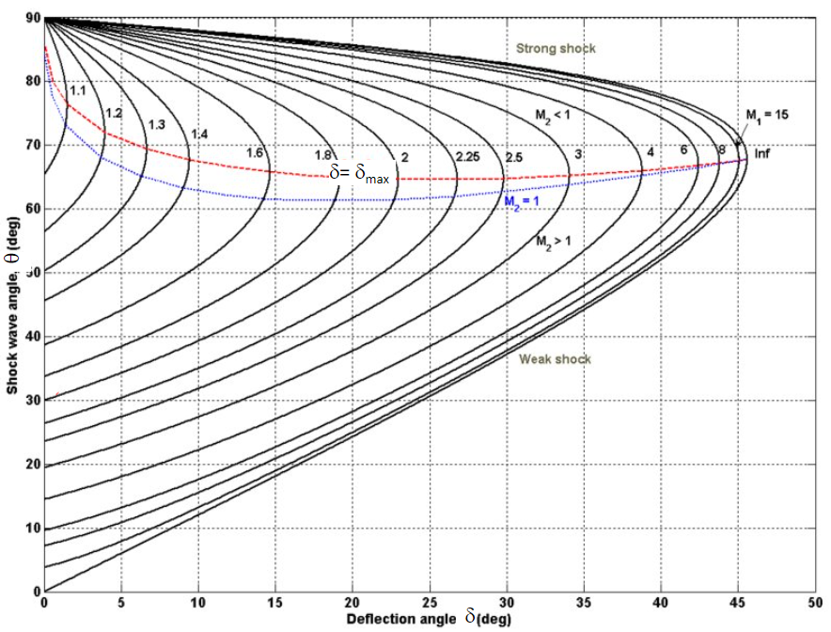

Slide 4
M₁ | M₂ | p₂/p₁ | ρ₂/ρ₁ | T₂/T₁ | p₀₂/p₀₁ D=DX | u2/u1
1.01 | 0.9901 | 1.0235 | 1.0167 | 1.0066 | 1 | 0.983527
1.26 | 0.8071 | 1.6855 | 1.446 | 1.1657 | 0.9857 | 0.691592
1.27 | 0.8016 | 1.7151 | 1.4634 | 1.172 | 0.9842 | 0.68331
1.28 | 0.7963 | 1.7448 | 1.4808 | 1.1783 | 0.9827 | 0.675297

Slide 5
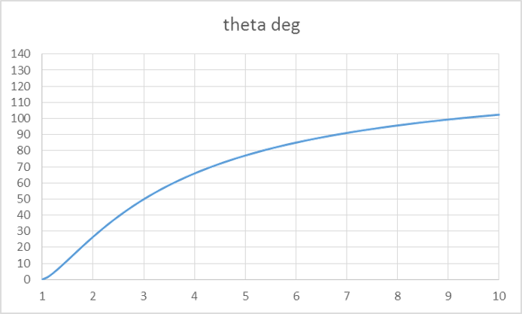
For the hypersonic plane at the point on the underside between stage 3 and stage 4 (see figure in question), if the stage 3 Mach number is 4.7, and the expansion angle is 15°, what is the Mach number at stage 4? [6.7]

Slide 6
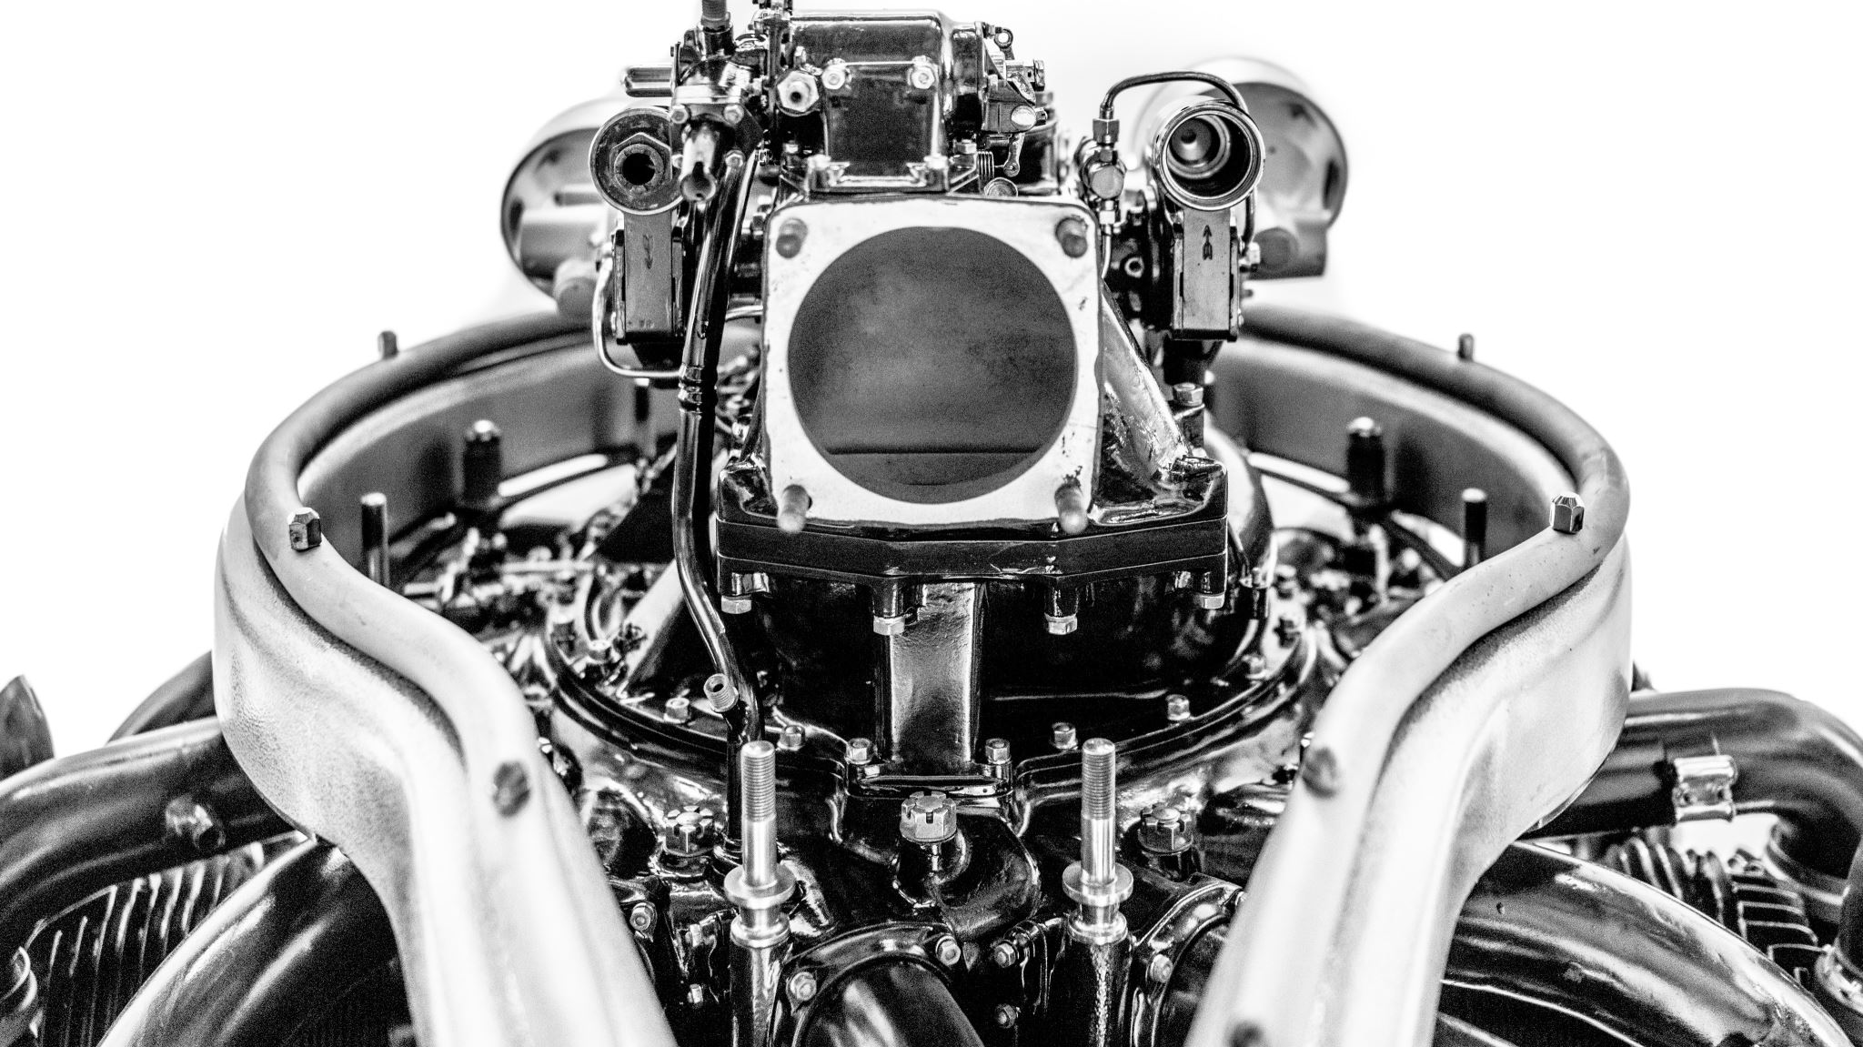
Turbo machines

Slide 7
Euler work equation
From dynamics
$${\dot{W}}_{c}=−{\dot{W}}_{x}=\dot{m}\left(h_{02}−h_{01}\right)=τ_{A}ω=\dot{m}\left(U_{2}c_{θ2}−U_{1}c_{θ1}\right)$$
From thermodynamics
From fluid mechanics

Slide 8
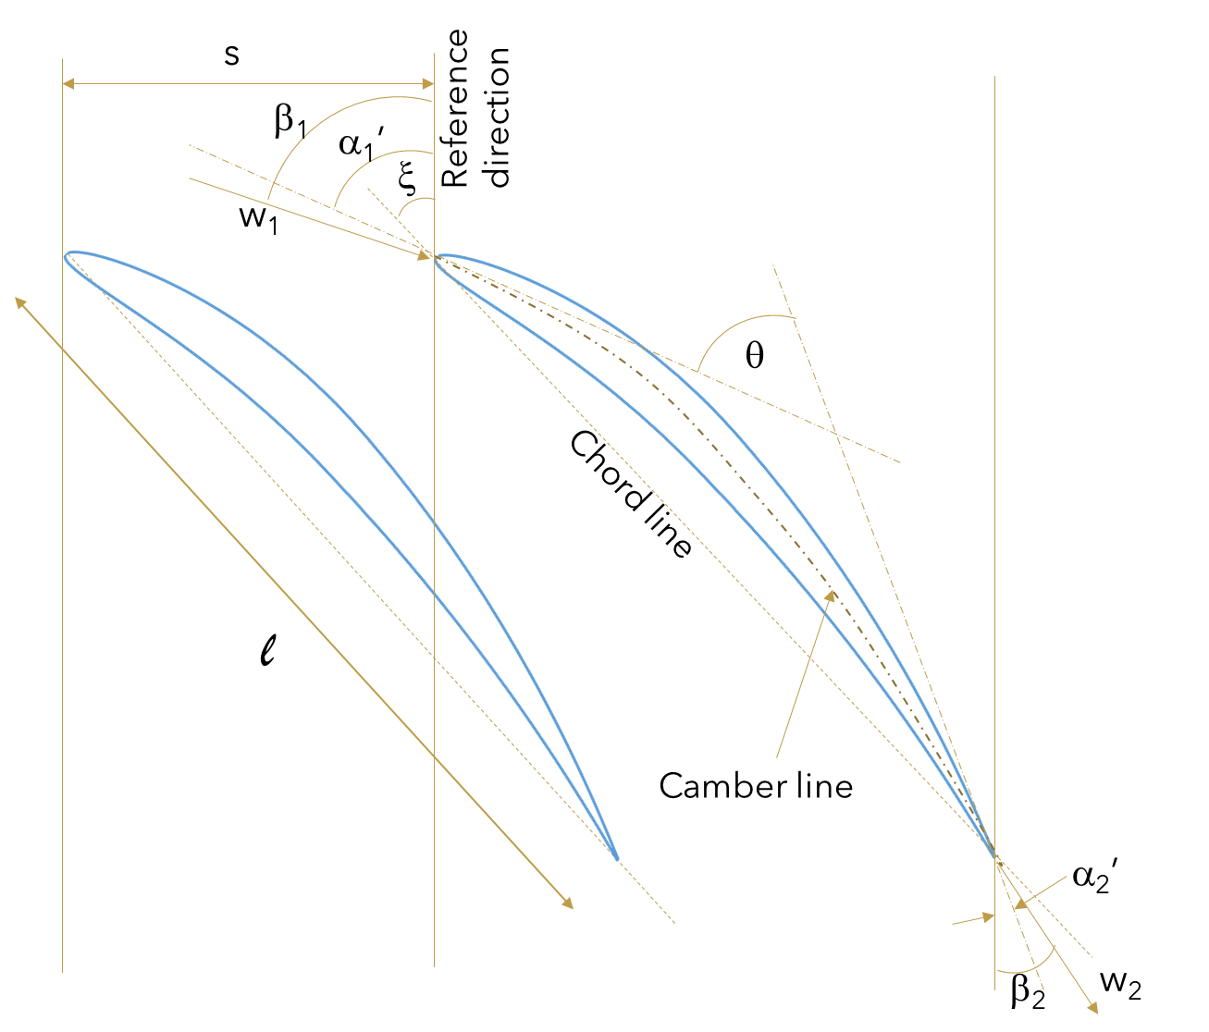
Blade anatomy and nomenclature

Slide 9




Mean line design Repeating stage design
$$∅=\frac{c_{x}}{U}$$
$$ψ=\frac{{∆h}_{0}}{U^{2}}=\frac{Δc_{θ}}{U}$$
$$R=\frac{h_{2}−h_{3}}{h_{1}−h_{3}}=\frac{p_{2}−p_{3}}{p_{1}−p_{3}}$$
$$ψ=∅\left(tanβ_{3}+tanβ_{2}\right)$$
$$R=\frac{φ}{2}\left(\tan{β_{3}−\tan{β_{2}}}\right)$$

Slide 10
Reaction
c₂
w₃
c₂
w₃
Exit
Entry
Exit
Entry
w₂ (= w₃)
c₃
c₃
w₂
β₃
β₂ = β₃
β₂
U
U
Zero reaction stage rotor:
no axial velocity change,
It can be shown that (relative velocity angles) β₂ = β₃
Therefore (relative velocities) w₂ = w₃
Advantage: high stage loading
Disadvantage: chance of separation – highly cambered blades
Use: steam turbines
50% reaction stage rotor:
Symmetrical velocity triangles
Similar stator and rotor blade shapes, high acceleration and
lower turning and hence lower losses
Advantage: subsonic Mach numbers
Disadvantage: increased number of stages required
Use: gas turbines and steam turbines

Slide 11
Example: A turbine stage has a desired flow coefficient of 0.8, reaction of 0.5 and stage loading of 5.1. Find the entry and exit relative flow angles and sketch the velocity triangles; calculate the axial velocity and given that the blade speed is 100 m/s, calculate the swirl angles, α. [68.7°, 75.0°, 80 m/s, 75.0°, 68.7°]

Slide 12
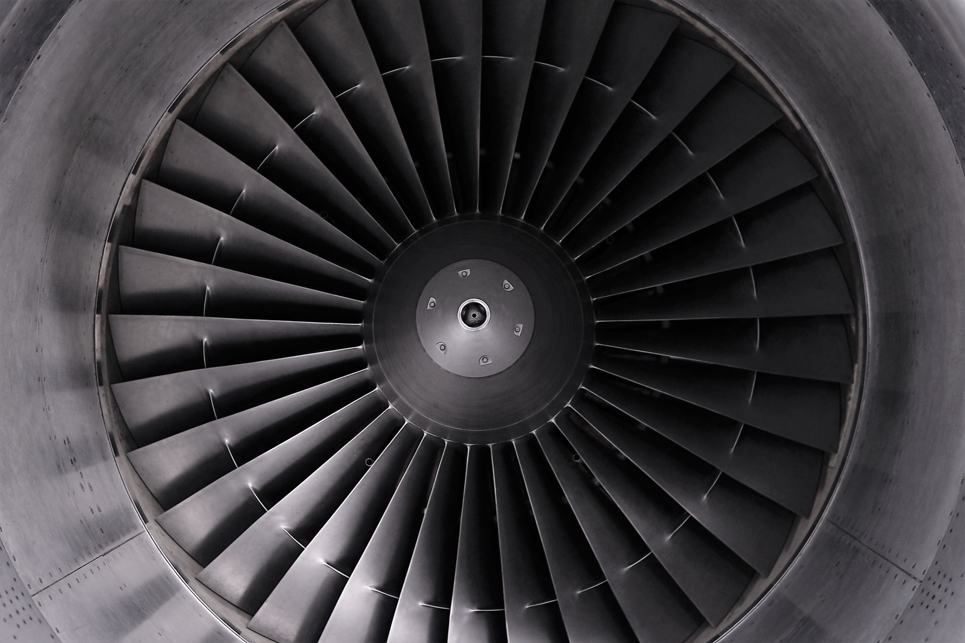
Turbine vs. compressor
Compressor blades are thin and have low curvature, reducing the suction side separation risk and causing little flow passage restriction, lowering shock risk
Turbine blades can take a much higher loading per stage and are therefore thick and strong, and they turn the flow much more, since flow turning is related to amount of work done by Euler work equation.

Slide 13
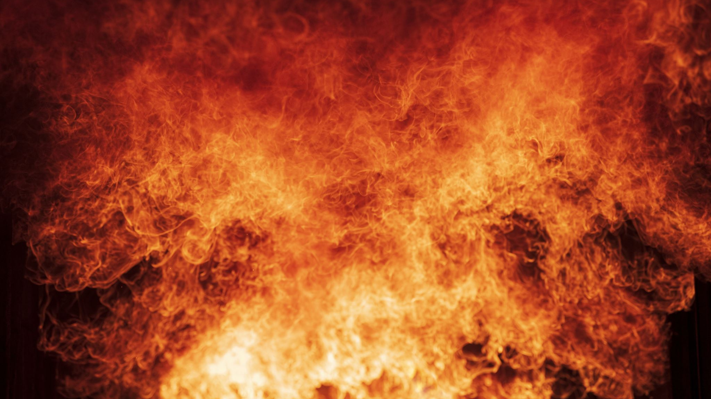
Combustion

Slide 14
Example: A reaction used in a gasifier is the ‘water-gas shift’ reaction: H₂ + CO₂ = H₂O + CO
The temperature in the gasifier is 1327°C. Find the reaction equilibrium constant for this reaction at that temperature. What does it mean for the balance of the reactants and products?
[ln K = 1.091, since it is not close to 7, it means it is not close to complete in the direction of the products, and as near 1 it is near to equal proportions]
Example: Use the enthalpies of formation method to find out whether the reaction is endothermic or exothermic in the forward direction. [+41160, endothermic]

Slide 15

Exergy

Slide 16
Example: A gas compressor has a gas mass flow rate of 20 kg/s and inlet condition 288 K, 1 bar, and outlet condition 580 K, 8 bar. The zero condition is 1 bar, 288 K. Calculate the irreversibility of this situation. c_{p} = 1.005 kJ/kgK, R = 0.287 kJ/kgK. [5868 kW]

Slide 17
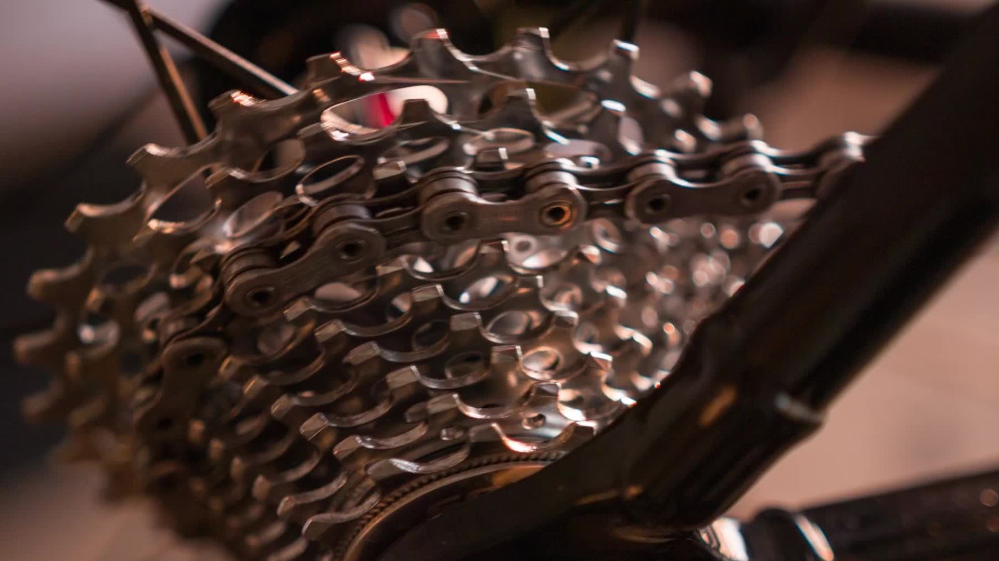
Review of Steam Turbine Cycles

Slide 18
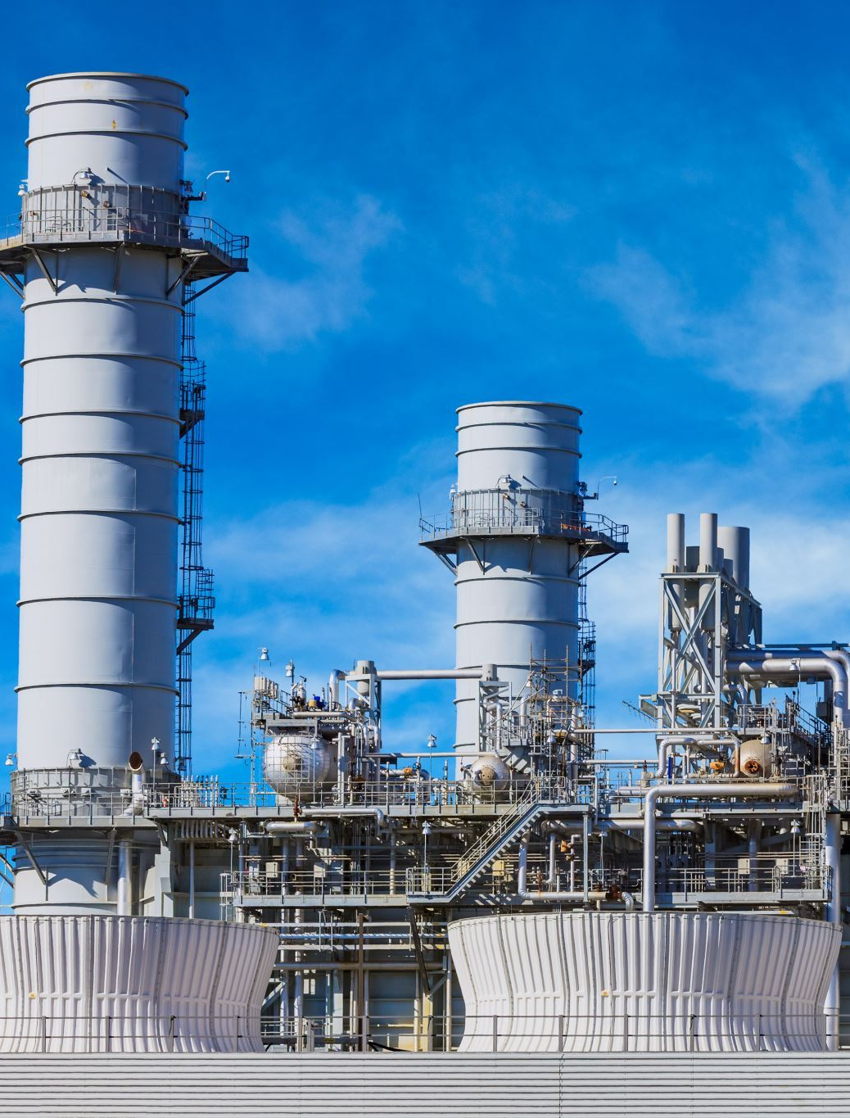
Feed Heating
Purpose is to heat the boiler feedwater in the economiser (where the water is heated to boiling point) so that the lower temperature heating is done using thermal energy from the steam rather than from external heat

Slide 19
Open feed heater
A propotion of steam is extracted part way through the turbine expansion and mixed directly with the feed water at the pressure of the steam
The feedwater must be pumped from the lower pressure up to this intermediate steam pressure
The proportion of steam required is determined by a simple enthalpy addition of the mixing streams
The lowest pressure open heater in a steam cycle is used as a de-aerator to remove air from the cycle
An extra pump is required due to the intermediate water pump pressure

Slide 20
Example: An isentropic steam cycle with pressure 160 bar and superheat temperature 550°C has a feed-heater that raises the feedwater temperature from 40°C to 150°C by extracting steam at 5 bar from the turbine. How much steam is extracted? (0.2) What is the cycle efficiency? (w, 1303 kJ/kg, q, 2794 kJ/kg, 0.47) Compare with no feed heater case. (1420 kJ/kg, 0.435)

Slide 21
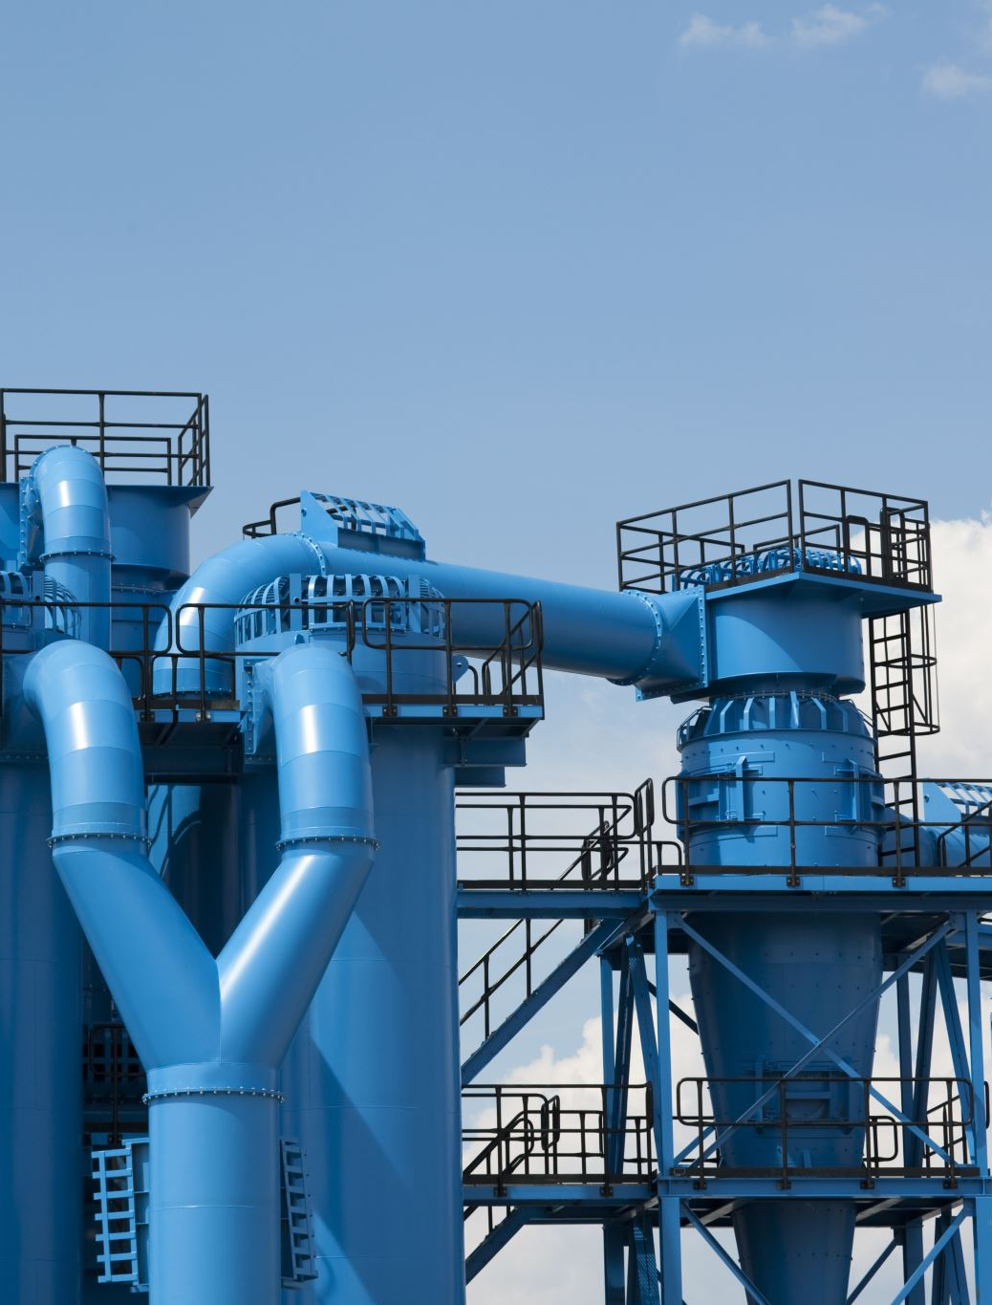
Closed feed heater
A proportion of steam is extracted from the steam turbine at an intermediate pressure, higher than the pressure of the open feed heater
This steam exchanges heat via a heat exchanger with the feedwater after the open feed heater
The steam condenses in the heat exchanger and then is 'flashed' through a throttle to the lower pressure where it becomes low quality wet steam added to the open feedheater
The cost is high because of the heat exchanger cost

Slide 22
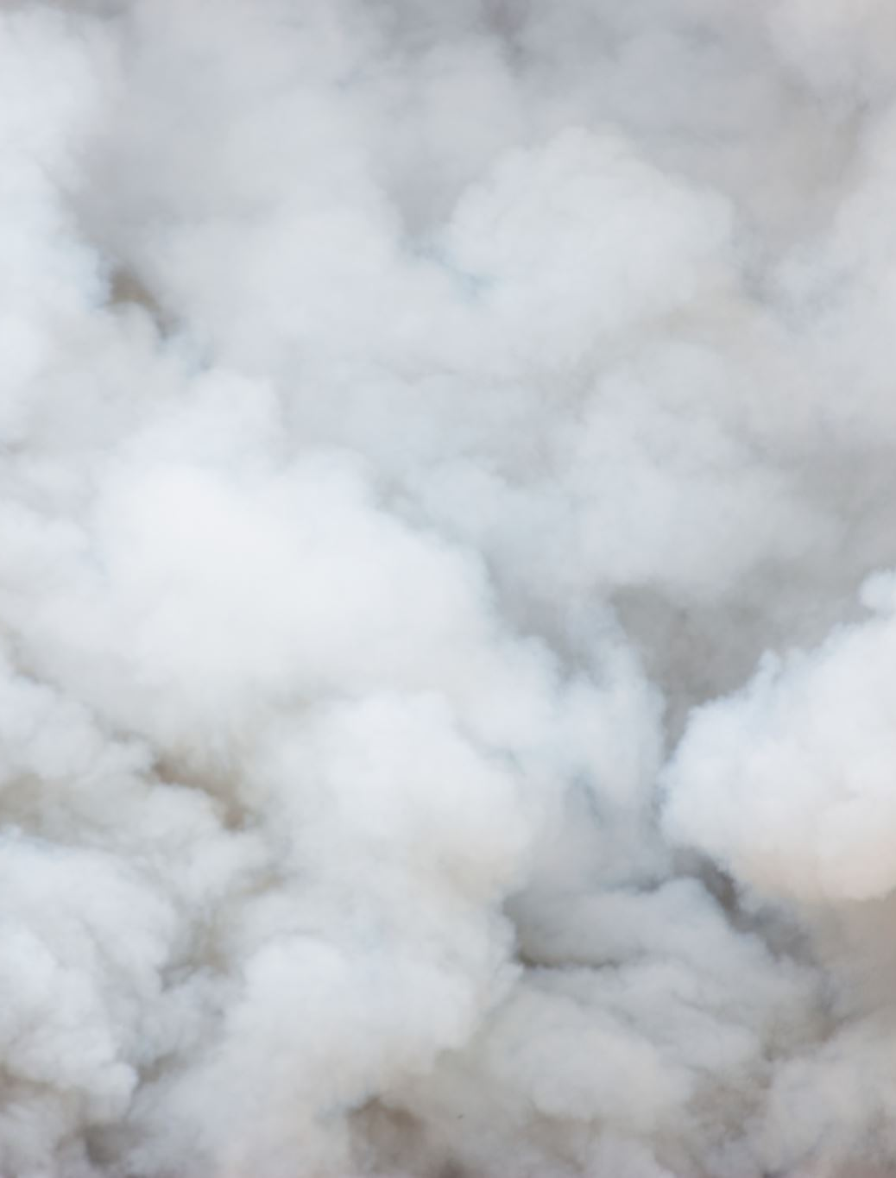
Steam reheating
The purpose is to heat the steam at an intermediate pressure in the turbine expansion process
It raises the average temperature at which external heat is added to the cycle and increases the thermal efficiency.
It increases dryness at low pressure turbine exhaust
Essential for supercritical steam cycle to improve dryness at low pressure exhaust

Slide 23
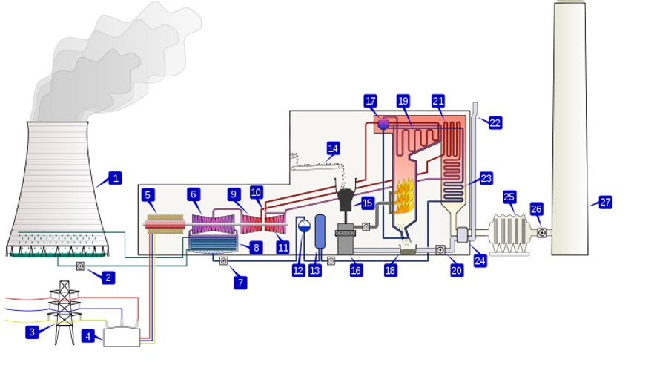
17 steam drum
19 superheater
21 reheater
23 economiser (also on furnace walls)
10 HP turbine
9 IP turbine
6 LP turbine

Slide 24
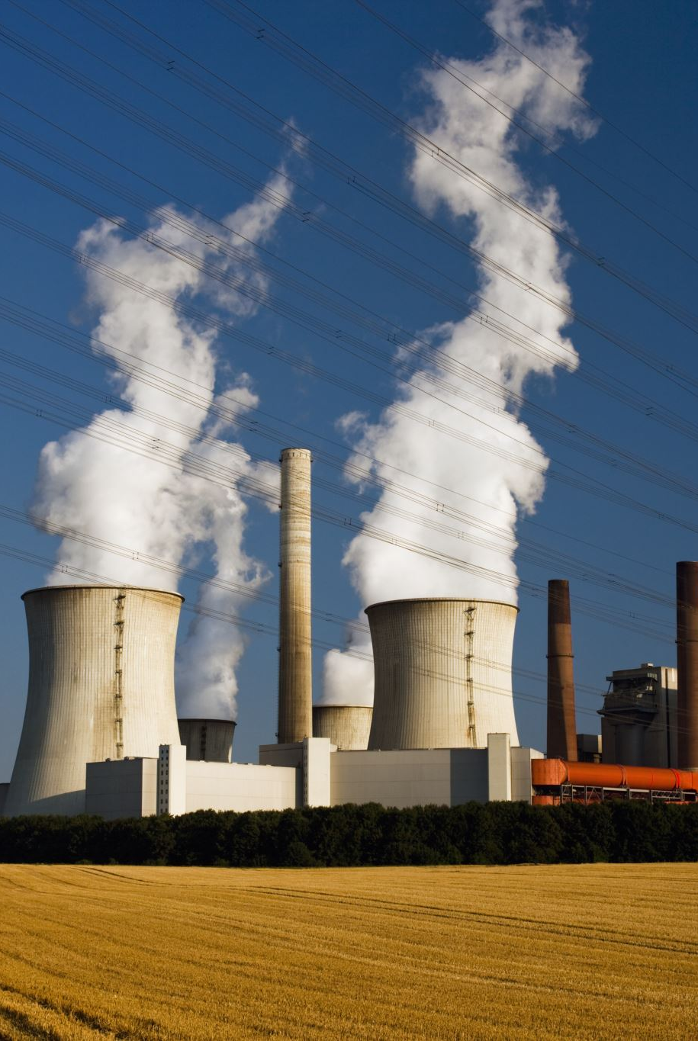
Heat recovery steam generation
When there is a source of thermal energy, other than a furnace boiler, it can be used to raise steam
Pinch temperature places a limit on the steam generation – it is the temperature between the saturated water point and the gas in the heat exchanger at that point
Approach temperature is the temperature difference between the superheated steam and the hot gas at entry to the heat exchanger
The source of thermal energy need not be a gas, but can be a molten salt for example

Slide 25
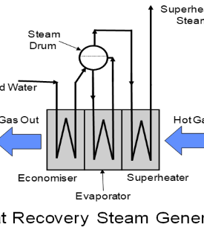
HRSG heat exchanger
The system is a counter flow heat exchanger shown here for a gas
The economiser heats water to saturation point
The steam drum separates saturated water into the evaporator and saturated steam into the superheater

Slide 26
Heat exchanger temperature profile
There is a big temperature difference between the exhaust gas heating the steam and the steam in the evaporator heat exchanger
Big temperature differences leads to large irreversibility in the boiler which can be shown by exergy analysis
Calculation of steam mass flow rate is done by an enthalpy balance on the evaporator and superheater section, making use of the pinch point temperature
Q_{economiser}
Q_{evaporator}
Q_{superheater}

Slide 27
Example: A heat recovery steam generator works with 30 kg/s of gas entering at 450°C and a pinch temperature of 30°C. c_{p} = 1.33 kJ/kgK. The steam pressure is 25 bar and the approach temperature is 100°C. Calculate the steam mass flow rate, and the isentropic power out. (3.163 kg/s, 1918.0 kW) What is the gas outlet temperature? (182°C) What is the cycle efficiency? (20%)

Slide 28
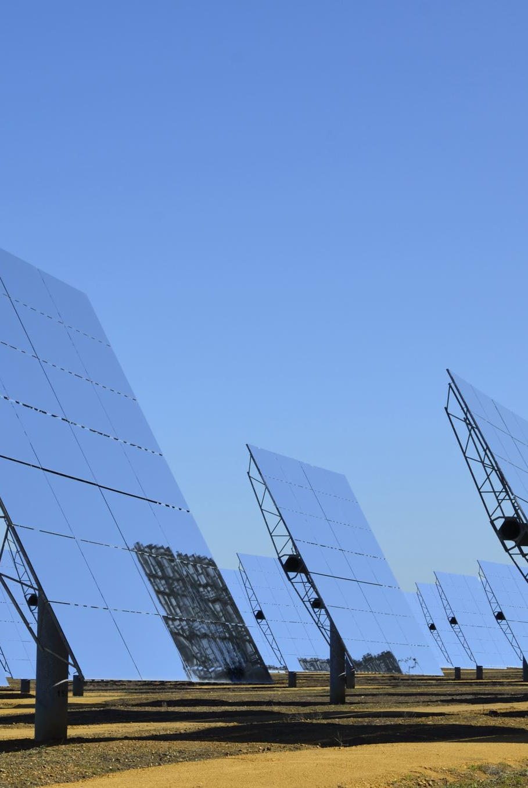
Solar steam cycle
Solar thermal energy can produce high pressure steam in the case of solar towers
Solar linear systems can produce moderate pressure steam
Coupled with high tension direct current electricity transmission this could enable use of desert region energy to power distant requirements

Slide 29

Organic Rankine cycles
Steam works at high pressures and temperatures, but other fluids can be used at lower temperature and pressure
Organic fluids tend to have a positive saturation vapour curve meaning that wetness after expansion is not such an issue as in steam cycles
Good for lower temperature and lower power systems

Slide 30
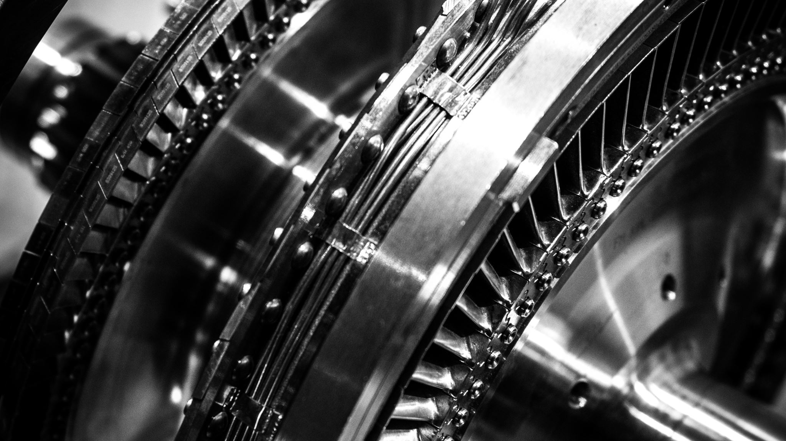
Gas Turbine Cycles

Slide 31
Brayton (gas turbine) Cycle air-cycle analysis
Simplified analysis of gas turbine
Assume air throughout with constant gamma and cp
Assume heat is added without any additional mass flow
Specific work into the compressor is m.c_p.ΔT
Specific heat input is m.c_p.ΔT
Specific work out of the turbine is m.c_p.ΔT
Work processes are isentropic

Slide 32
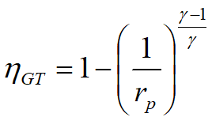

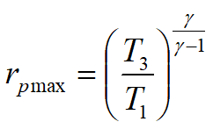
Measures of performance
Efficiency depends on pressure ratio, r_p:
Ideal pressure ratio is:
In which:

Slide 33
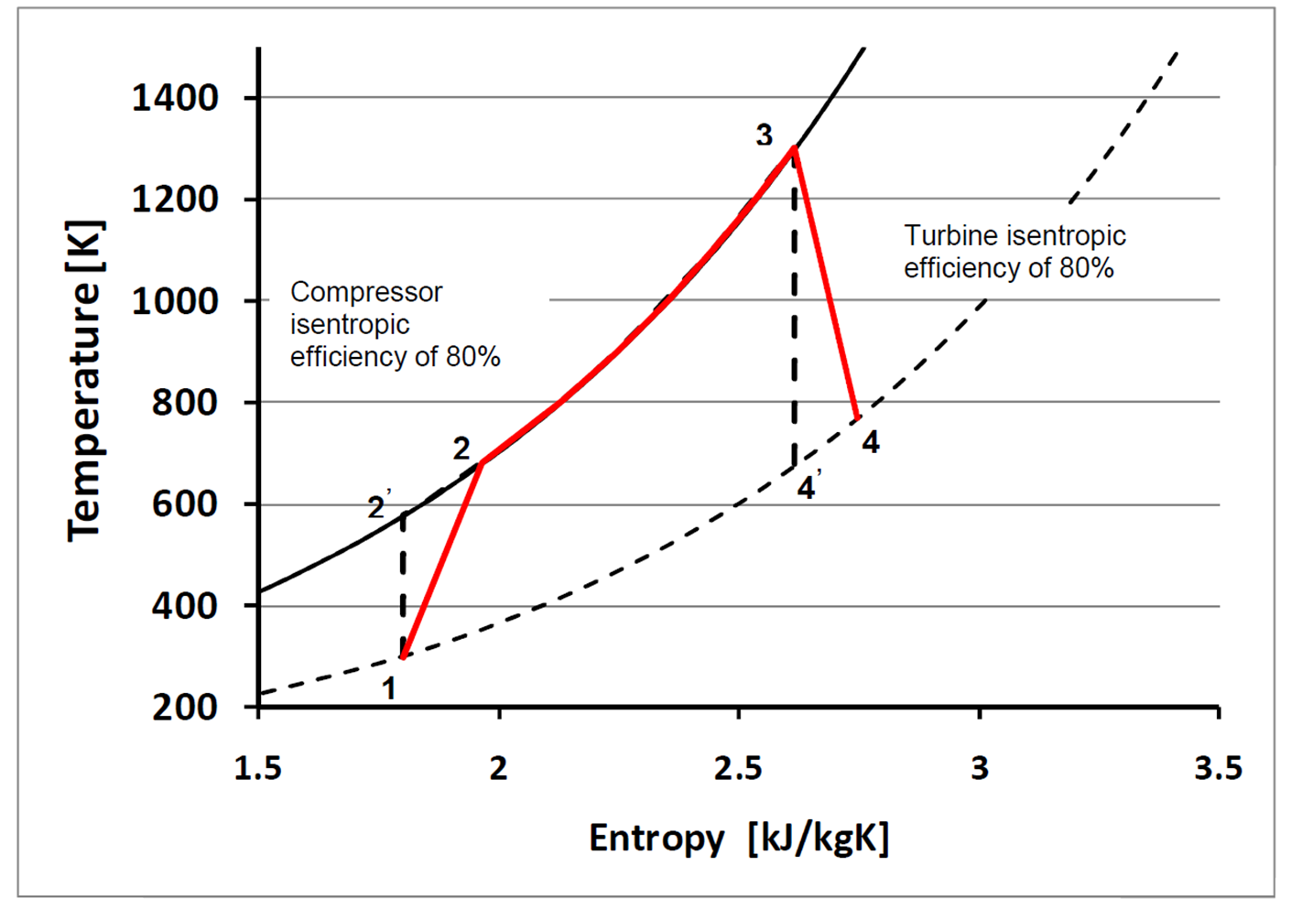
Isentropic efficiency increases work input to the compressor and reduces work output from the turbine calculated by: divide isentropic work by isentropic efficiency for compressor multiply isentropic work by isentropic efficiency for turbine

Slide 34
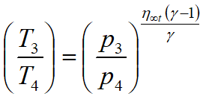
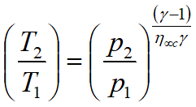
Polytropic efficiency
Improved representation of irreversibility by representing the 'small stage' isentropic efficiency, which varies between different pressure stages
Pressure lines diverge on the T-s diagram meaning that isentropic efficiency for the whole turbine cannot represent the case for varying pressure
Use polytropic efficiency to find the outlet temperature of the compressor and turbine instead of isentropic efficiency

Slide 35
Example: Compare the compressor outlet temperature for isentropic and polytropic efficiency of 85% for a pressure ratio of 8 and ingoing temperature 288 K. [562 K, 579 K]

Slide 36
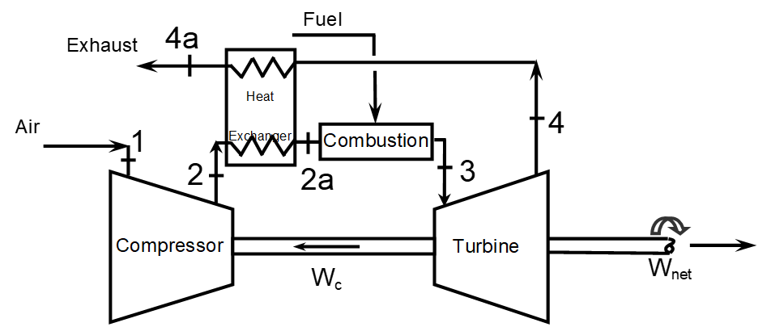
Heat management to improve cycle efficiency
Recuperation of the turbine exhaust
Use the turbine exhaust in a heat exchanger to increase the temperature of the compressor exit gas
Increases cycle efficiency by raising average temperature of external heat addition

Slide 37
Example: A turbine has an exhaust temperature of 800 K and a compressor outlet temperature of 580 K. cp of the exhaust is 1.15 kJ/kgK and cp of the compressor gas is 1.37 kJ/kgK and the mass flow doesn’t change. Given a recuperator of effectiveness 0.75, what saving in energy can be made by this recuperation? [189.8 kJ/kg of gas flow]

Slide 38
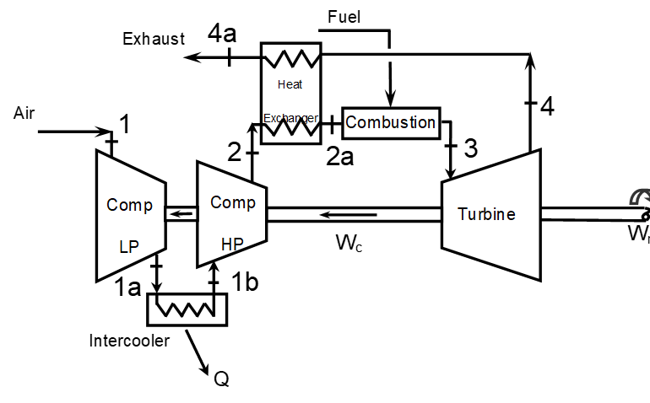
Heat management to improve cycle efficiency
Intercooling part way through the compressor
Reduces the work input by reducing the specific volume of the gas
Requires a heat exchanger

Slide 39
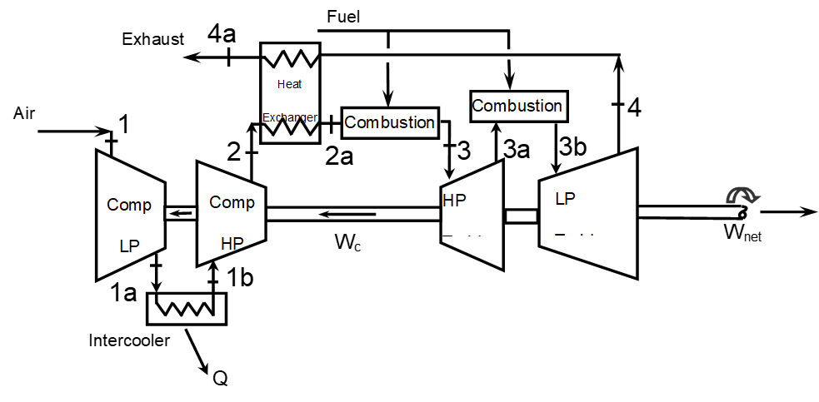
Heat management to improve cycle efficiency
Reheat gas part way through turbine expansion
Improves cycle efficiency by raising the average temperature of heat addition
Similar to same process in steam cycle

Slide 40
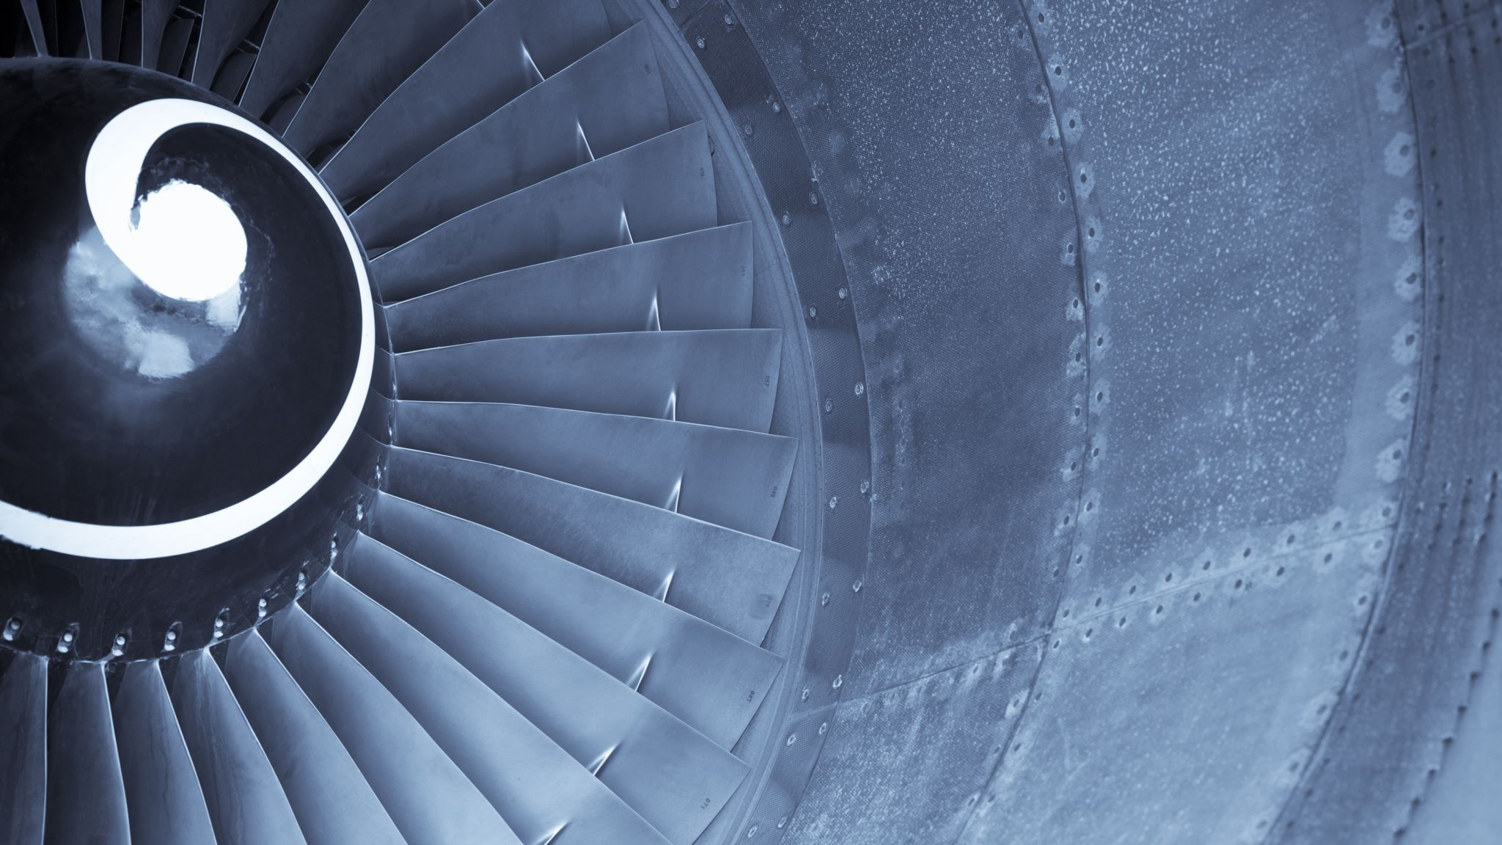
Real gas turbine cycle effects
Pressure losses in ducting and in stage passages in turbo machines
Mechanical losses in turbo machines and in generator
Gas property variation in compressor and turbine
Mass flow variation due to fuel injection
Mass flow variation due to compressor air bleed to cool the turbine

Slide 41
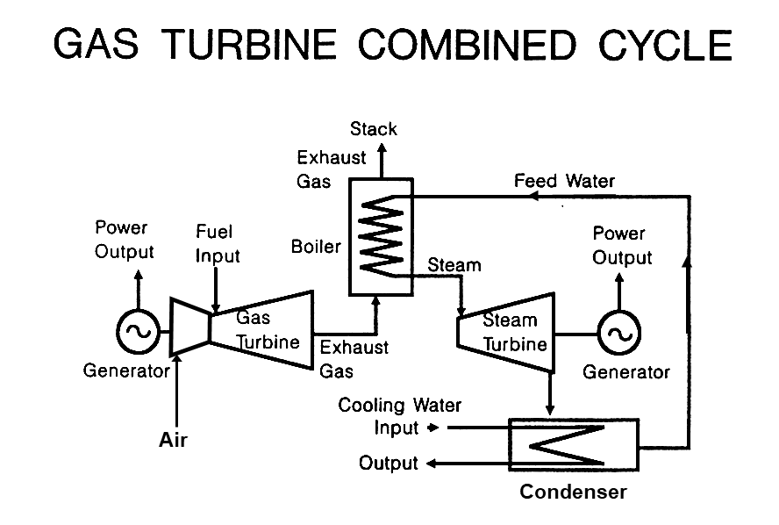
Gas turbine applications
Limitation on NOx emissions requirement
Large power generation for steady load
Medium power generation with aero engine for variable load due to split shaft
Turbo-compressor type design for small load
CCGT, using the hot gases from a gas turbine exhaust to power a HRSG producing very high cycle efficiency

Slide 42
Example: Given the gases from a GT exhaust at 800 K, with a mass flow of 20 kg/s and cp = 1.15 kJ/kgK, what steam power can be raised from this using HRSG? Assume 20 bar and approach temperature of 100 K and pinch of 30 K. [a mass flow rate of 2.73 kg/s of steam at 3307 kJ/kg can be raised at 20 bar using this thermal energy without the details of the steam turbine it is difficult to estimate properly, but taking an outflow from the turbine at Tsat = 40°C, an estimated isentropic work output is 2.9 MW]

Slide 43
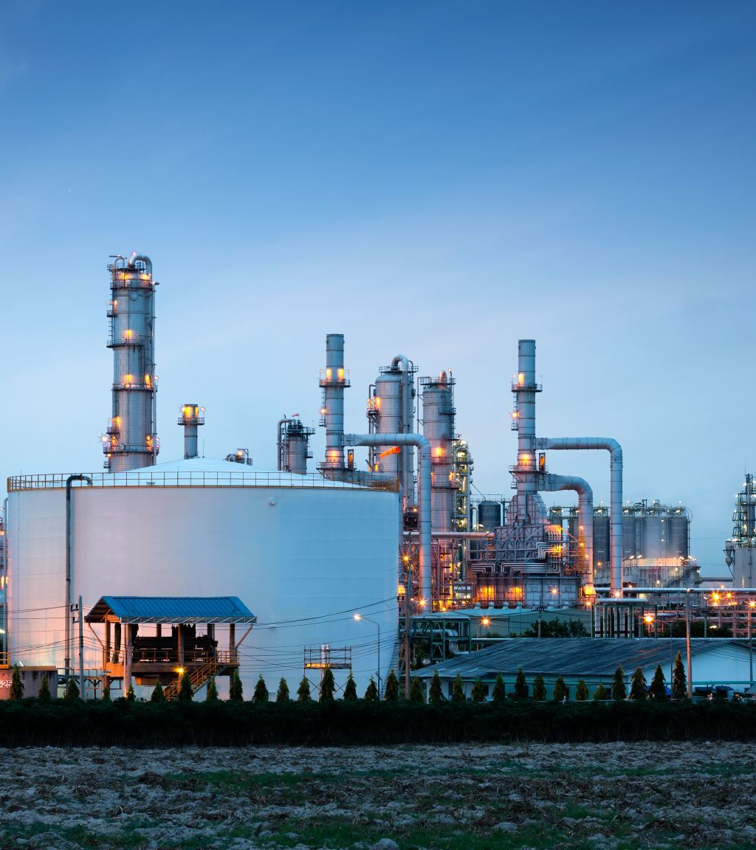
Further applications
Integrated gasifier combined cycle gas turbine
With addition of carbon capture pre-combustion after the gasifier
CC captures CO2 but reduces cycle efficiency

